Slide 1
A turn-based strategy game to evaluate Multi-Armed Bandit policies in an adversarial setting

Slide 2
CONTENT
01
02
03
Introduction
Definition of the game
Development of the game
The MAB problem
Mining in the space
The architecture, graphic and data structure

Slide 3
CONTENT
04
02
05
4
5
6
Algorithms
Results
Conclusion
The used Algorithms

Slide 4

1
Introduction

Slide 5
INTRODUCTION
The Multi-Armed Bandit problem: an optimal learning topic used to make decisions over time in an uncertain environment
An example: multiple slot machines with different probabilities of winning.
The mechanism: pulling a lever with a related unknown reward and with a limited set of resources to be allocated in different alternatives with partial information available.
The goal: predict the expected value of each arm's reward as close as possible to the real reward value. By finding the best trade-off between exploration and exploitation.

Slide 6

2
Definition of the game

Slide 7
‘MINING IN THE SPACE’ GAME
Mars
Venus
Uranus
Replacement of the slot machines by planets: Mars, Venus and Uranus
1 or 2 spaceships are guided by MAB algorithms
The goal: building up the best strategy to own as many crystals as possible
The spaceships travel from the home planet to the three planets
The time variable is based upon 10000 iterations
Home

Slide 8
‘MINING IN THE SPACE’ GAME
Mars
Venus
Uranus
Every planet updates its production of crystals at every iteration based upon the probability distribution
‘learning and optimization’ task
The only context information the spaceships know is the number of crystals they own and collect at each landing
The performances are evaluated based upon the number of crystals collected
Every planet has a different distance from the home planet
Home

Slide 9
MAB STRATEGIES EVALUATED ON TWO SETTINGS:
Contextual
Adversarial

Slide 10

3
Developement of the game

Slide 11
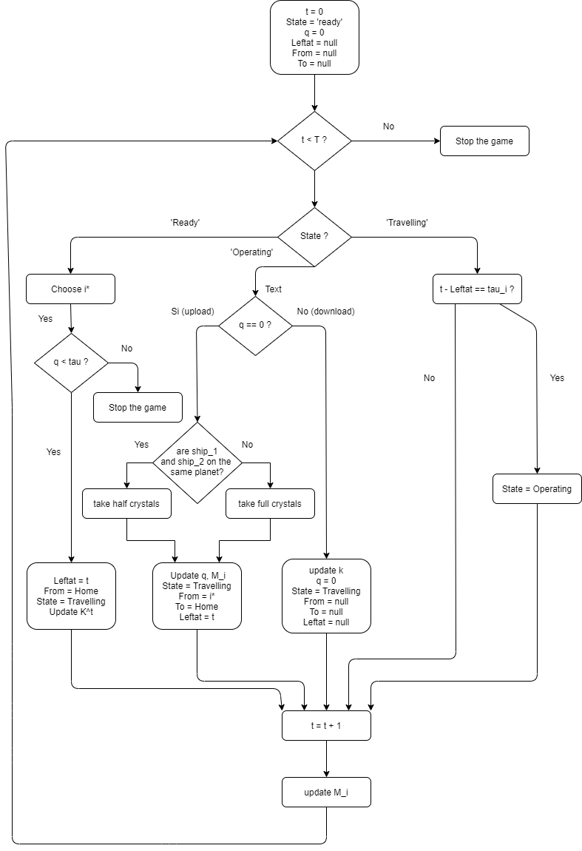

Slide 12
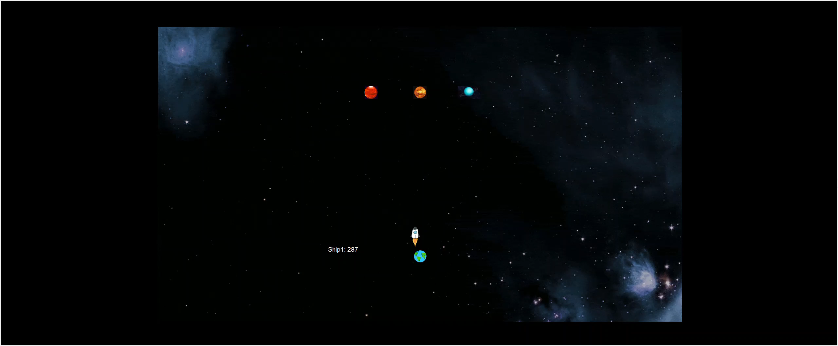

Slide 13
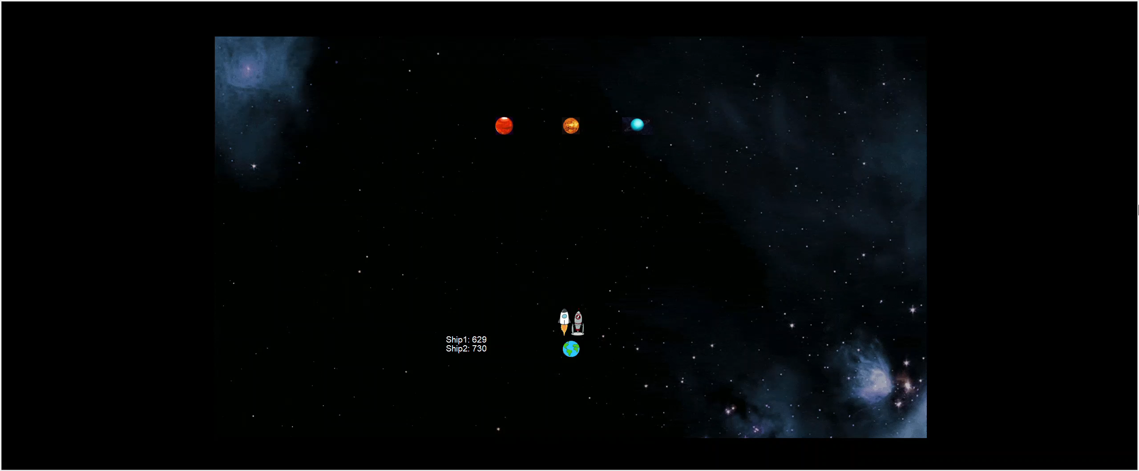

Slide 14
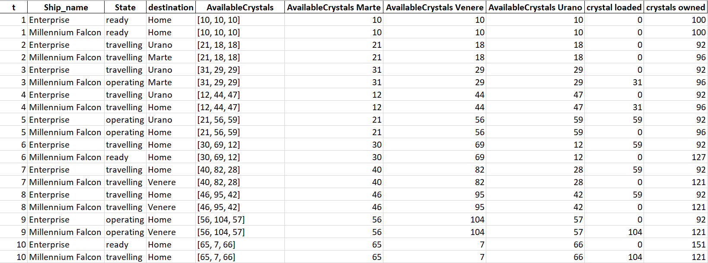
DATA STRUCTURE

Slide 15

4
The used algorithms

Slide 16
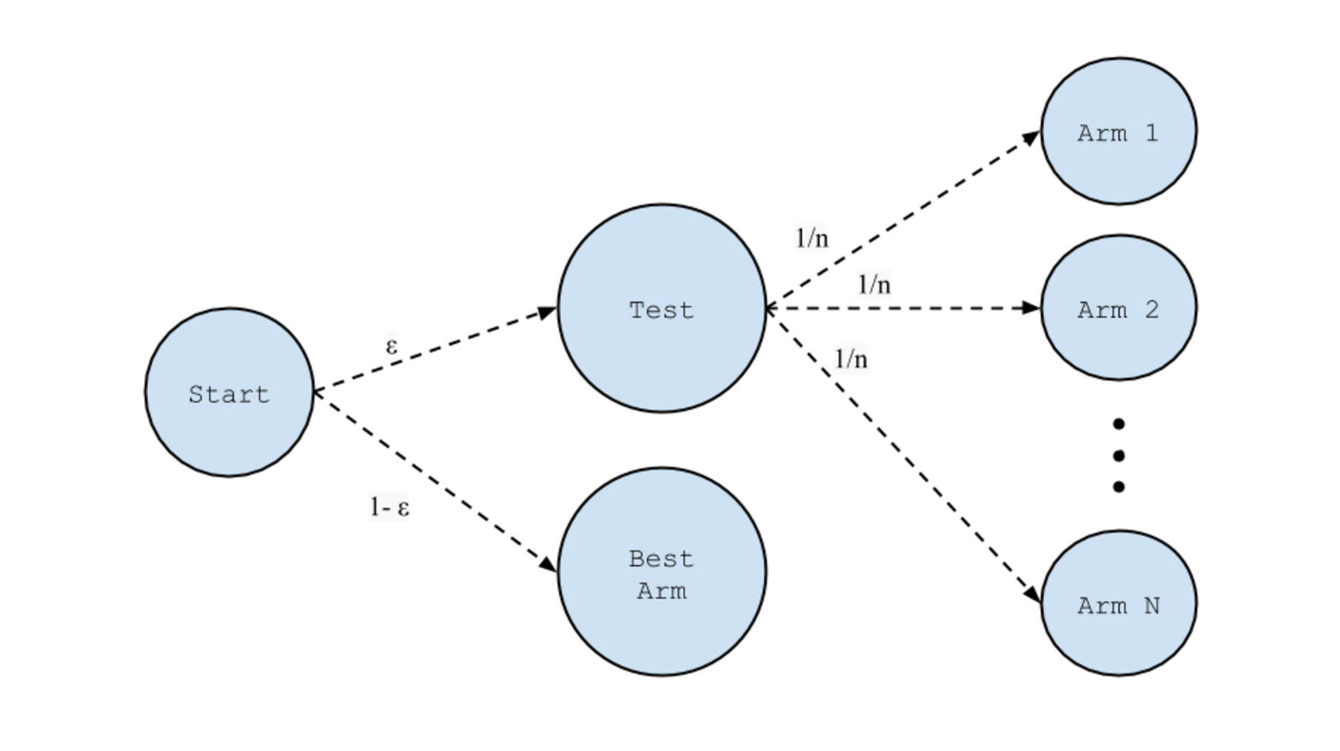
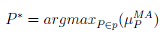
The Mean algorithm
The Epsilon-Greedy algorithm
A purely exploitative Algorithm
It chooses the planet that has guaranteed the most significant number of crystals to the spaceship
His policy is the greedy action
Not used as standalone algorithm

Slide 17
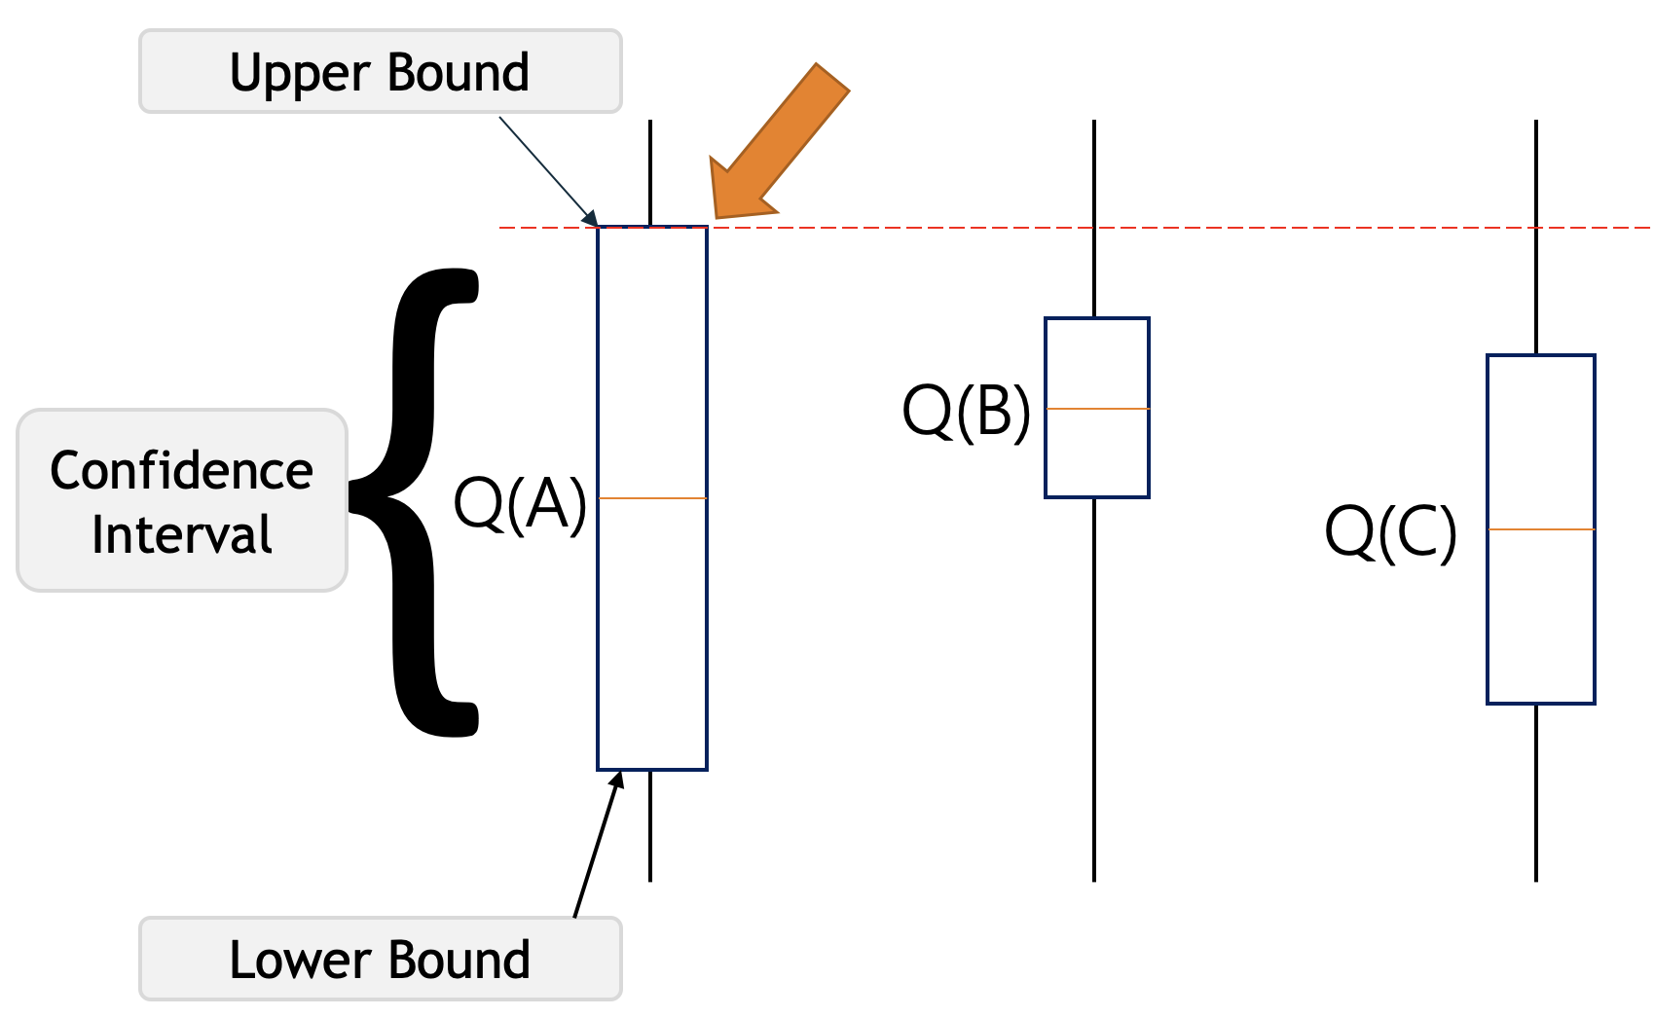
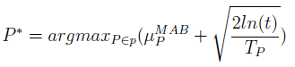
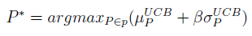
The Time Elapsed Based MAB algorithm
The Upper Confidence Bound algorithm
It is driven by the ‘optimism in face of uncertainty’ principle
The Time Elapsed Based MAB algorithm also belongs to the UCB algorithm family
The more times the spaceship has been on a planet, the less bonus it adds to the mean of crystals mined from it.

Slide 18
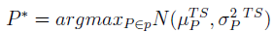
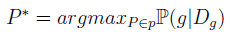
The Thompson Sampling algorithm with Probability Matching
The Thompson Sampling algorithm
It creates a probability model from the rewards until that time obtained and afterwards, it samples from these rewards to choose the destination planet
A variation of the previous Algorithm
The Probability Matching part consists of predicting the distribution based upon the rewards gained until that time.

Slide 19

5
Results

Slide 20
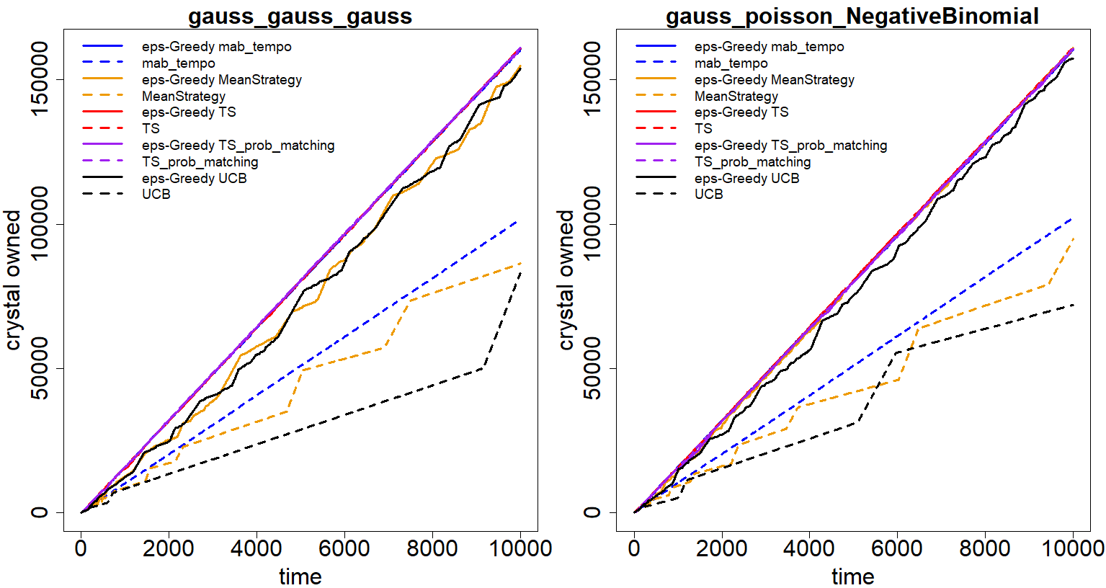

Slide 21
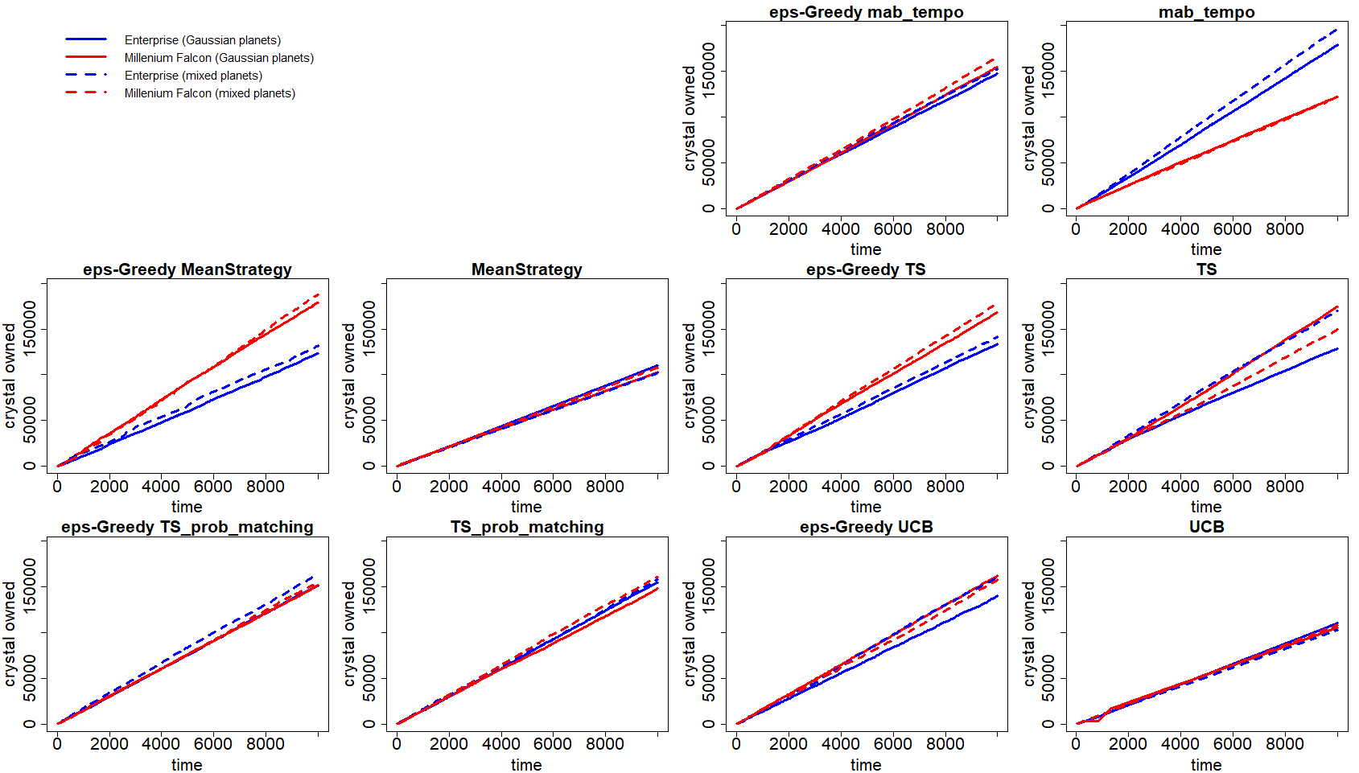

Slide 22
6
Conclusion

Slide 23
CONCLUSION
A framework is created to test and compare different MAB strategies in the two contexts.
Limitation: just basic strategies are used.
Future developments: use new adversarial strategies, new strategies proposed in literature and include a human player.

Slide 24
Thank you
Do you have any questions?

